Slide 1
Superfluidity of Neutron Star Matter
Quinn White
Mentor: Dr. Kevin Schmidt
Arizona State University
April 17, 2021

Slide 2
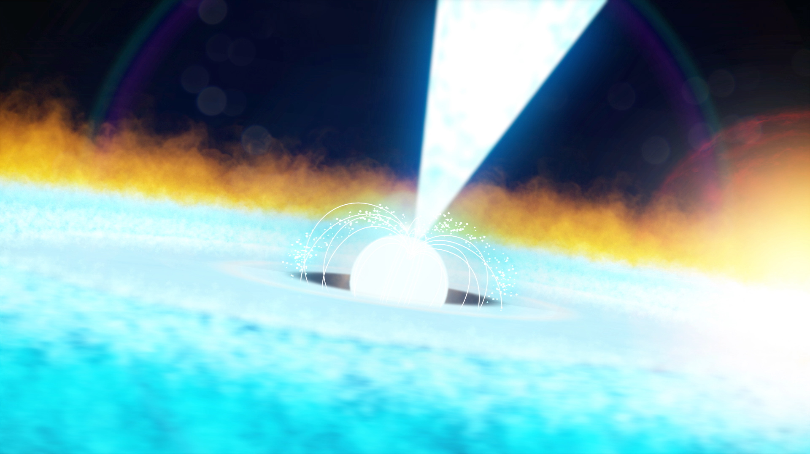
Introduction
Neutron stars are the incredibly dense remains that exist following the collapse of certain large stars.
Current ongoing experimental work being done to investigate their structure (i.e., NASA NICER mission, LIGO/VIRGO).
Superfluid neutron matter proposed to explain observed “glitches” in pulsar rotation rates.
Figure 1: Artist rendition of a pulsar (nasa.gov)

Slide 3
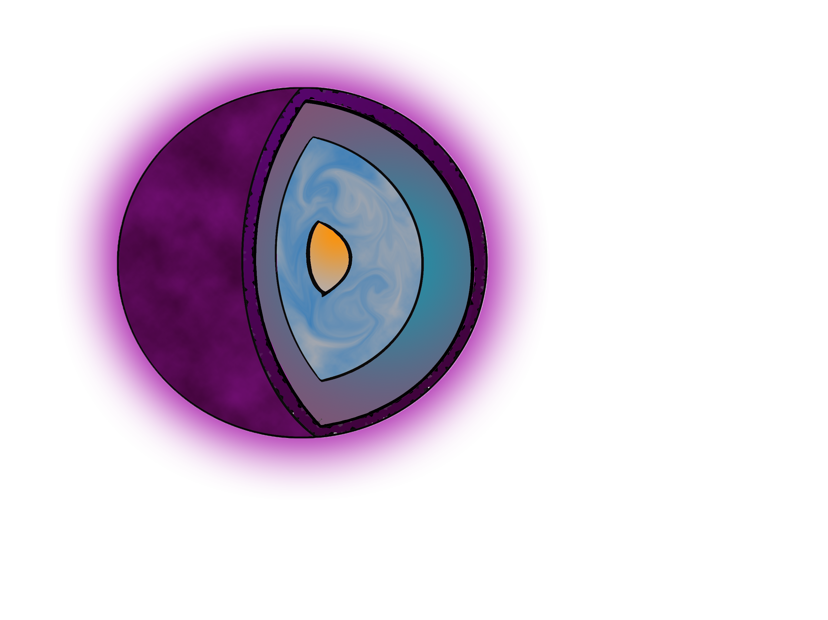
Superfluid Neutron Matter
Superfluid neutrons expected in the inner crust and outer core.
Current calculations are performed assuming pure neutron matter.
To calculate the superfluid gap ∆ we need to determine the systems ground state energy.
We calculate this using quantum Monte Carlo methods.
Outer crust: ions, electrons
Inner crust: ion lattice,
superfluid neutrons
Outer core: superfluid neutrons, superconducting protons
$$\sim 2ρ0$$
$$\sim ρ0$$
Inner core: unknown
Figure 2: Diagram of neutron star structure (adapted from NICER mission overview).

Slide 4
Diffusion Monte Carlo
Map the Schrödinger equation to a diffusion equation by moving to imaginary time $τ=it$.
Simulate the diffusion of particles to obtain our ground state wave function.
Wave function allows us to calculate the energy and superfluid gap for a system of N neutrons.
absorption rate
diffusion

Slide 5
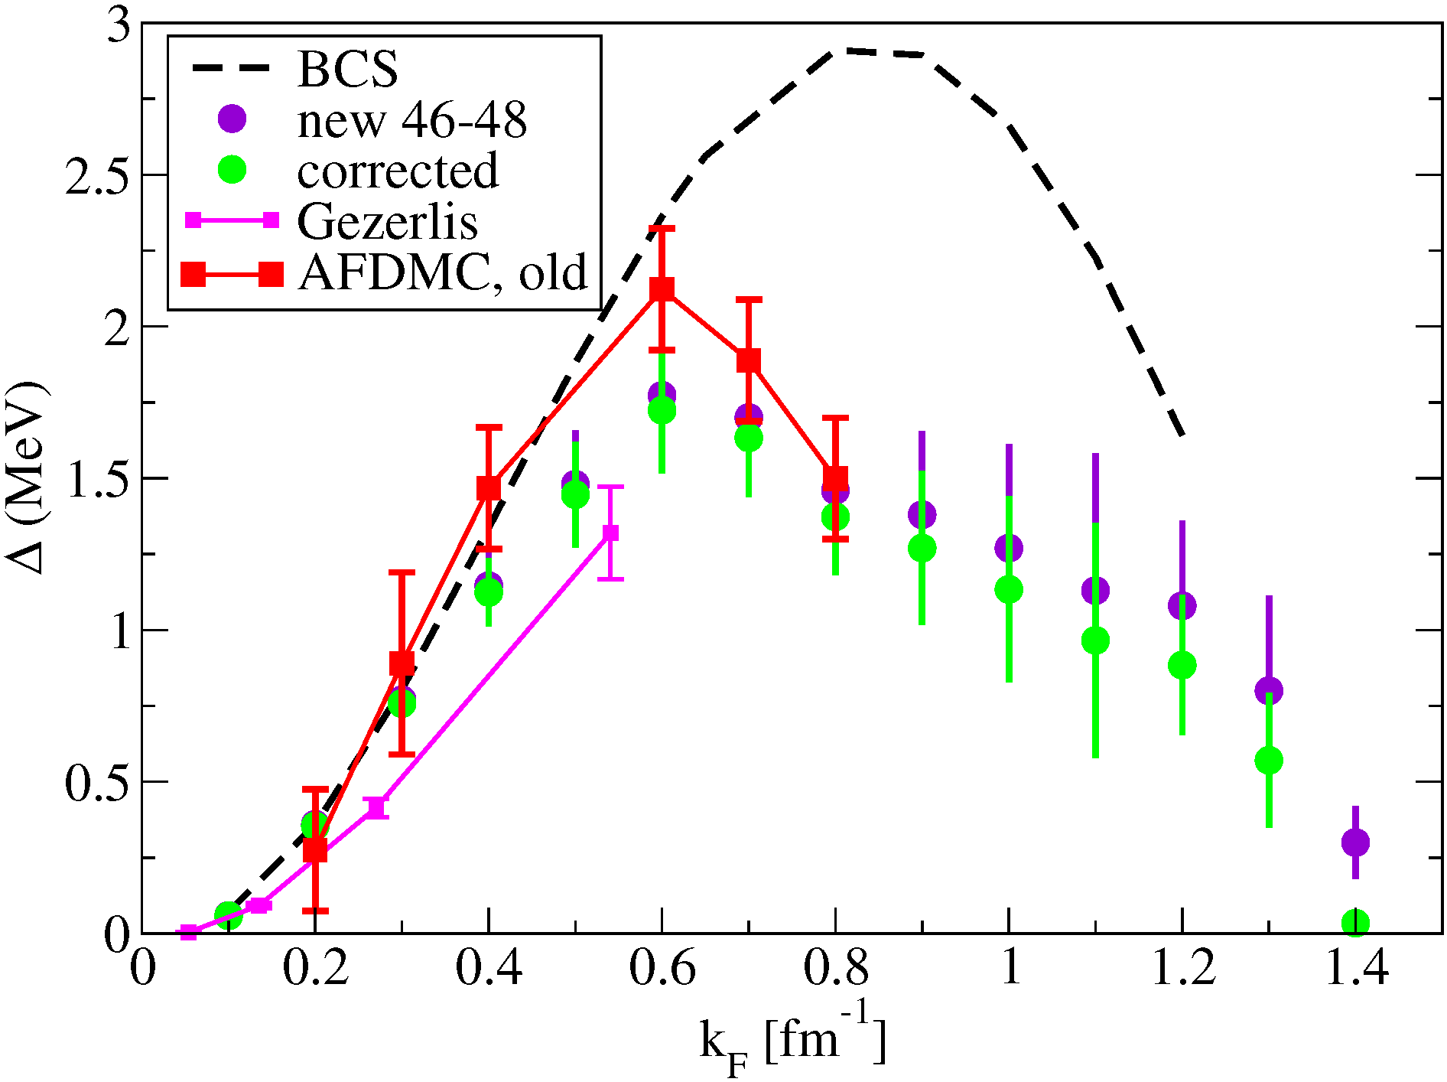
Previous Work
BCS calculation overestimates the superfluid gap at higher densities with a max ∆ of roughly 3 MeV.
Previous auxiliary field diffusion Monte Carlo (AFDMC) results predicted a maximum gap of approximately 2.1 MeV.
Recent improvements by collaborators has resulted in a lower value at about 1.75 MeV.
Figure 3: Calculation of the $1S0$ pairing gap as a function of the Fermi momentum k_{F} . (Private communication with Stefano Gandolfi, preliminary results, Gezerlis et al., 2008).

Slide 6
Current Work
Accurate trial wave functions should include spin dependent correlations.
Currently working to introduce linear correlations to improve trial wave functions.
Linearly correlated trial wave functions will be used in new AFDMC calculations and are expected to improve results at higher densities.
Linear correlations

Slide 7
Acknowledgments
Dr. Kevin Schmidt
NSF LEAP Scholars Program
NASA Space Grant
References
[1] Nicer mission overview. (n.d.). Retrieved February 03, 2021, from https://heasarc.gsfc.nasa.gov/docs/nicer/nicer_about.html
[2] Gezerlis, A., & Carlson, J. (2008). Strongly paired fermions: Cold atoms and neutron matter. Physical Review C, 77(3), 032801.

Slide 8
Thank You!
Contact: qmwhite@asu.edu

